Slide 1
Tech For Climate
ML
Notes:
Good Afternoon everyone. My Name is Aryan Chopra and I will be handling the ML part for this workshop. ML is a really hot topic nowadays am I right? I hope you are all excited for this. The rundown for this segment is first I’ll explain the basic terms of ML then we will do some codes for basic models.

Slide 2
What is artificial intelligence?
Artificial intelligence is the ability of a computer to perform tasks commonly associated with intelligent beings.
Notes:
It encompasses various technologies like machine learning, deep learning, and natural language processing, enabling machines to analyze data, make decisions, and adapt to changing circumstances autonomously.

Slide 3
What is machine learning?
Machine learning is the study of algorithms that learn from examples and experience instead of relying on hard-coded rules and make predictions on new data.

Slide 4
What is deep learning?
Deep learning is a subfield of machine learning focusing on learning data representations as successive layers of increasingly meaningful representations.
Notes:
For instance, in image recognition, deep learning can automatically identify objects, like cats or dogs, in photos by learning from millions of labeled images, mimicking how the human brain processes visual information.

Slide 5
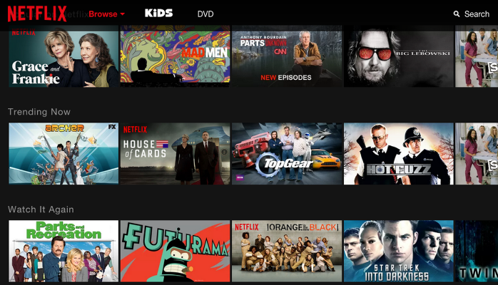
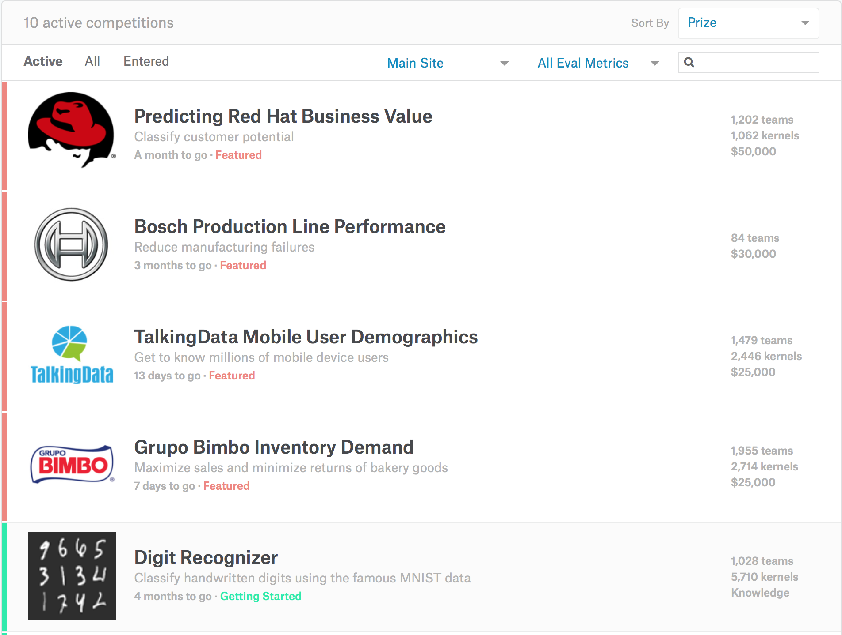

AI in real-life
Notes:
Photo 1: Netflix's AI-Powered Recommendations
Here, we see a revolutionary advancement in the entertainment industry.
This photo represents Netflix's cutting-edge AI algorithms that power their recommendations.
By analyzing your viewing habits and preferences, Netflix uses AI to suggest content, transforming how we discover and enjoy movies and shows.
Photo 2: Google DeepMind's Breakthroughs in Deep Learning
In this image, we witness the incredible strides made by Google DeepMind.
Google DeepMind has been at the forefront of AI research, achieving breakthroughs in deep learning, reinforcement learning, and more.
Their work has implications across industries, from healthcare to gaming, and their AI systems are pushing the boundaries of what's possible in AI technology.
Photo 3: Red Hat and the World of Coding Competitions
Our final photo brings us into the heart of coding competitions.
Red Hat, known for its open-source contributions, plays a crucial role in fostering innovation through coding competitions.
These competitions encourage problem-solving, collaboration, and the development of AI and programming skills among aspiring developers and data scientists.

Slide 6
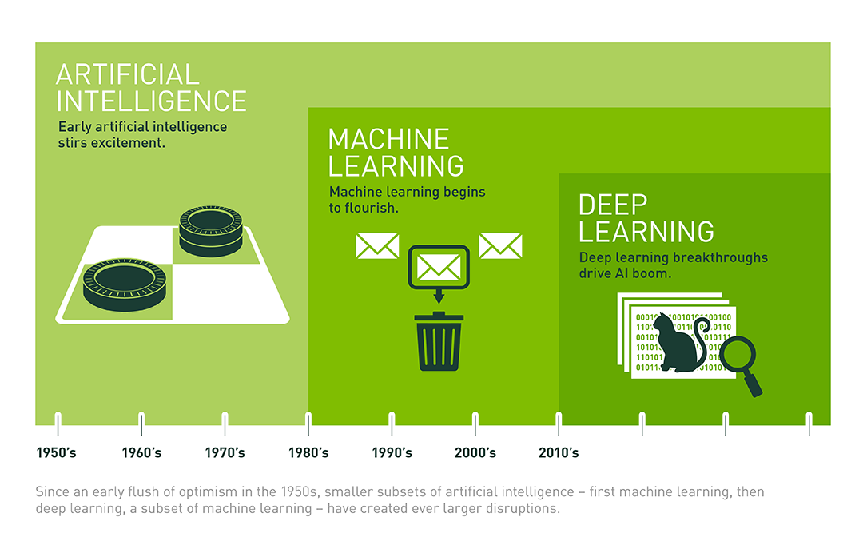
Notes:
1950s: AI was born, focusing on symbolic reasoning. Early efforts included the Logic Theorist, a program that could prove mathematical theorems.
1960s: Symbolic AI continued, with programs like ELIZA attempting natural language understanding. Machine learning concepts emerged.
1970s: Expert systems emerged, but AI faced funding challenges due to unmet expectations.
1980s: AI winter hit as symbolic AI fell short. Expert systems remained popular.
1990s: Machine learning approaches, like neural networks, gained traction. Data-driven methods showed promise.
2000s: Advances in computational power and data availability revitalized AI and machine learning.
2010s: Deep learning, a subset of machine learning, led to breakthroughs in image and speech recognition.
2020+ AI, ML, and deep learning played pivotal roles in addressing global challenges, including the COVID-19 pandemic. AI-driven models helped analyze and predict the virus's spread.
The deployment of AI-powered chatbots and telehealth solutions surged as remote healthcare became crucial.
Deep learning models achieved groundbreaking results in natural language understanding, enabling more advanced virtual assistants.
The integration of AI into industries like finance, manufacturing, and cybersecurity accelerated, reshaping how businesses operate and adapt to a rapidly changing world.

Slide 7
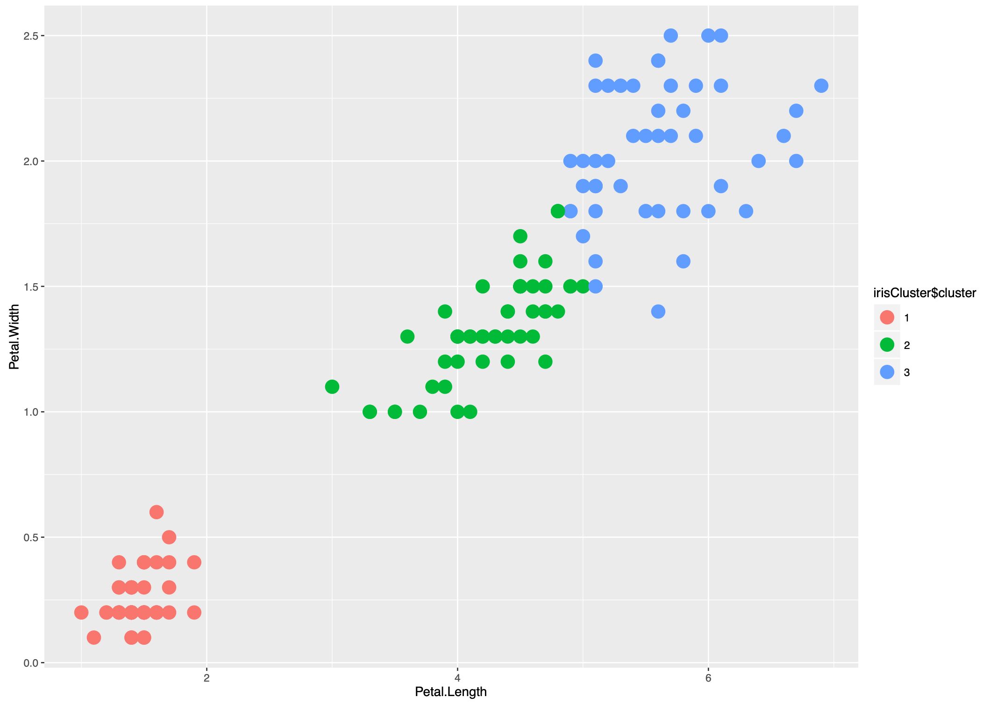
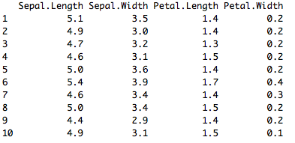
Supervised and Unsupervised Learning
Unsupervised Learning
There are not predefined and known set of outcomes
Look for hidden patterns and relations in the data
A typical example: Clustering
Notes:
Unsupervised learning is a machine learning technique where the algorithm learns patterns and structures in data without labeled outputs. An example is clustering, where data points are grouped into clusters based on similarities. For instance, in customer segmentation, unsupervised learning can group customers with similar buying behaviors, helping businesses tailor marketing strategies.

Slide 8
Supervised and Unsupervised Learning
Supervised Learning
For every example in the data there is always a predefined outcome
Uses labelled data
Models the relations between a set of descriptive features and a target (Fits data to a function)
2 groups of problems:
Classification
Regression
Notes:
Supervised learning is a machine learning paradigm where the algorithm learns to predict labeled outputs based on input data. A practical example is email spam classification, where the algorithm learns from labeled emails (spam and non-spam) to classify new incoming emails. It's widely used in applications like sentiment analysis, medical diagnosis, and object recognition.

Slide 9
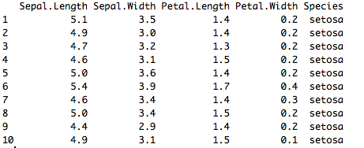
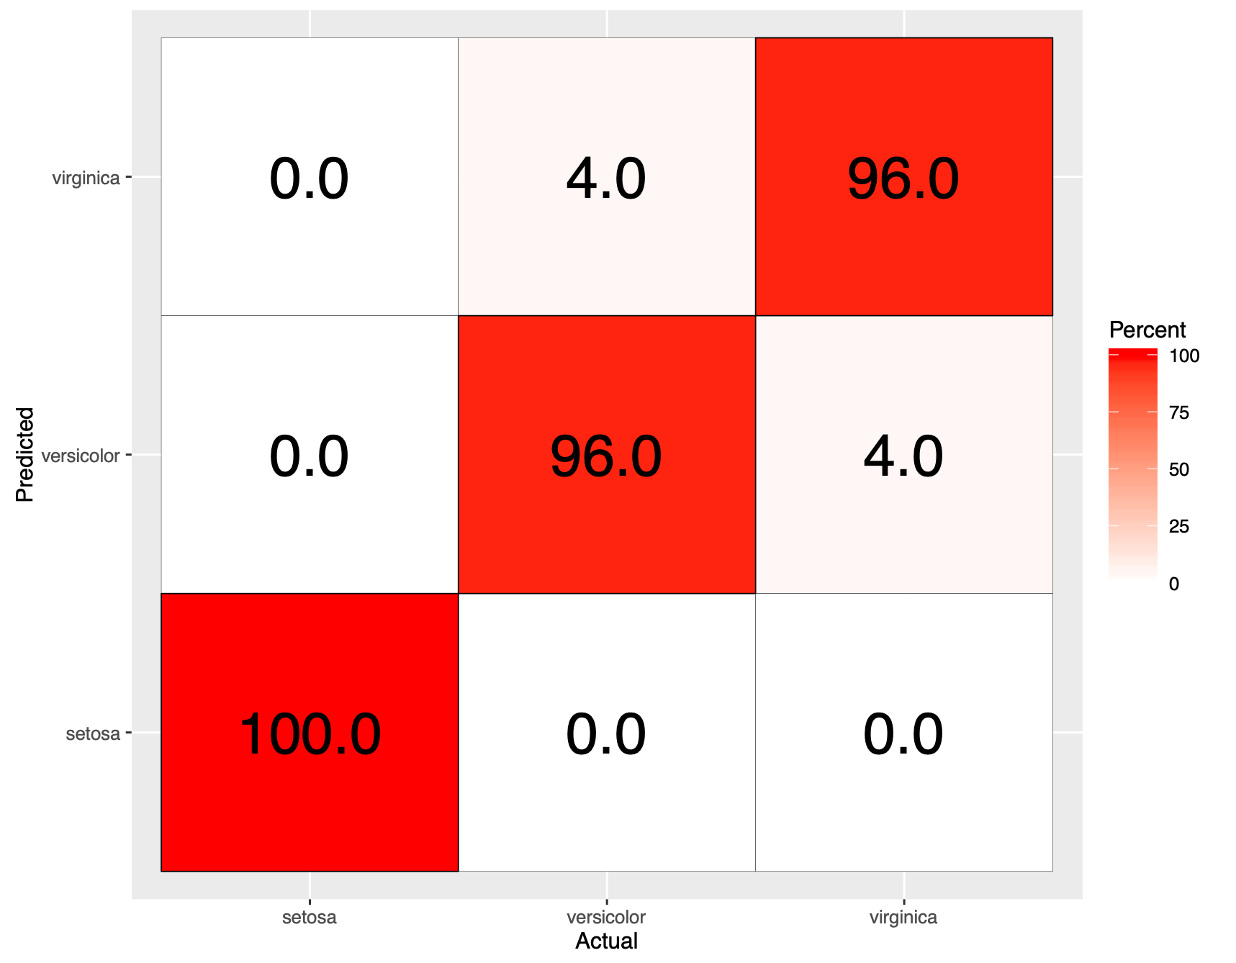
Supervised Learning
Classification
Predicts which class a given sample of data (sample of descriptive features) is part of (discrete value).
Regression
Predicts continuous values.
Notes:
Supervised learning in regression involves predicting a continuous numerical value based on input data. An example is predicting house prices based on features like size, location, and number of bedrooms. The algorithm learns from a labeled dataset of past house prices to make accurate predictions for new properties. It's applied in financial forecasting, weather prediction, and stock market analysis.

Slide 10
Machine Learning as a Process
Define Objectives
- Define measurable and quantifiable goals
- Use this stage to learn about the problem
Model Deployment
- Normalization
- Transformation
- Missing Values
- Outliers
Data Preparation
- Data Splitting
Features Engineering
Estimating Performance
Evaluation and Model Selection
Model Evaluation
Model Building
- Data Splitting
Features Engineering
Estimating Performance
Evaluation and Model Selection
Notes:
Defining Objective:
Clearly define the problem or objective you want to address with machine learning. Understand what you aim to achieve and what success looks like.
Data Preparation:
Gather, clean, and preprocess the data required for your project. This includes handling missing values, encoding categorical features, and scaling/normalizing numerical data.
Model Building:
Select an appropriate machine learning algorithm based on your problem type (e.g., classification, regression).
Train the model on the prepared data to learn patterns and relationships.
Model Evaluation:
Assess the model's performance using relevant metrics (accuracy, F1-score, RMSE, etc.).
Use techniques like cross-validation to validate the model's generalization.
Model Deployment:
Deploy the trained model in a production environment, making it accessible to users or integrated into existing systems.
Ensure that the model's predictions align with the defined objective and provide real-world value.

Slide 11
ML as a Process: Data Preparation
Needed for several reasons
Some Models have strict data requirements
Scale of the data, data point intervals, etc
Some characteristics of the data may impact dramatically on the model performance
Time on data preparation should not be underestimated
Raw Data
Missing Values
Error Values
Different Scales
Dimensionality
Types Problems
Many others
Scaling
Centering
Skewness
Outliers
Missing Values
Errors
Data Ready
Modeling phase
Data Transformation
Notes:
This can be divided into two steps: data collection and data preprocessing
Data Collection:
Gather relevant data from various sources, ensuring it's accurate, complete, and representative of the problem you're trying to solve.
Data Preprocessing:
Clean and preprocess the data by handling missing values, outliers, and formatting issues.
Transform categorical data into numerical format through encoding techniques.
Normalize or scale numerical features to ensure consistency.

Slide 12
ML as a Process: Feature engineering
Determine the predictors (features) to be used is one of the most critical questions
Some times we need to add predictors
Reduce Number:
Fewer predictors more interpretable model and less costly
Most of the models are affected by high dimensionality, specially for non-informative predictors
Binning predictors
Multiple models adding and removing parameter
Algorithms that use models as input and performance as output
Wrappers
Genetics Algorithms
Filters
Evaluate the relevance of the predictor
Based normally on correlations
Notes:
Main key points are Select and engineer relevant features that contribute to model accuracy.
Reduce dimensionality when dealing with high-dimensional data.
Consider domain knowledge for feature creation.

Slide 13
ML as a Process: Model Building
Data Splitting
Allocate data to different tasks
model training
performance evaluation
Define Training, Validation and Test sets
Feature Selection (Review the decision made previously)
Estimating Performance
Visualization of results – discovery interesting areas of the problem space
Statistics and performance measures
Evaluation and Model selection
The ‘no free lunch’ theorem no a priory assumptions can be made
Avoid use of favorite models unless needed.

Slide 14
Numpy NumPy, short for "Numerical Python," is a fundamental Python library for numerical and scientific computing. It provides support for large, multi-dimensional arrays and matrices, as well as a variety of high-level mathematical functions to operate on these arrays. NumPy is a foundational library for data manipulation and scientific computing in Python, and it's a crucial building block for various data science and machine learning libraries.
Arrays: NumPy's primary data structure is the numpy.ndarray, commonly referred to as an "array." Arrays are similar to Python lists but can have multiple dimensions (e.g., 1D arrays, 2D matrices, or even higher-dimensional arrays). They are homogeneous, meaning all elements within an array have the same data type (e.g., integers or floats).
Vectorization: NumPy promotes vectorized operations, which means performing operations on entire arrays (or sub-arrays) at once, rather than using explicit loops. This leads to more efficient and faster computations.
Element-wise Operations: NumPy allows you to perform element-wise operations, where operations are applied to corresponding elements of two or more arrays. For example, adding two arrays of the same shape results in element-wise addition.
Broadcasting: NumPy supports broadcasting, which is a set of rules for performing element-wise operations on arrays with different shapes. It allows you to work with arrays of different shapes as long as they are compatible.
Mathematical Functions: NumPy provides a wide range of mathematical functions and operations, including basic arithmetic, trigonometry, logarithms, exponentials, and more. These functions are optimized for numerical computations.
Random Number Generation: NumPy includes a powerful random number generation library (numpy.random) that enables you to generate random data for various simulations and experiments.
Array Manipulation: NumPy offers functions for reshaping, slicing, indexing, and manipulating arrays. You can extract specific elements, change the shape of an array, and perform various transformations easily.
Integration with Other Libraries: NumPy integrates seamlessly with other Python libraries commonly used in data science and scientific computing, such as SciPy (for advanced scientific functions), Matplotlib (for data visualization), and Pandas (for data manipulation).
Efficiency: NumPy is implemented in C and Fortran, which makes it highly efficient. It's optimized for numerical computations, making it much faster than equivalent Python code with loops.
Multidimensional Data: NumPy is particularly useful for handling multidimensional data, such as images, audio, or datasets. It provides tools for performing operations along specific axes and dimensions.
Notes:
Ok so by a show of hands how many are interested in theory of Numpy? Ok how many want to directly move to the code part?

Slide 15
import numpy as np # Import the NumPy library
# Creating a 1D NumPy array from a Python list
arr1d = np.array([1, 2, 3, 4, 5])
# Creating a 2D NumPy array (matrix)
arr2d = np.array([[1, 2, 3], [4, 5, 6], [7, 8, 9]])
# Accessing elements
element = arr1d[2] # Access the third element (index 2) of the 1D array
# Slicing arrays
slice_arr = arr1d[1:4] # Slice elements from index 1 to 3
# Array shape
shape = arr2d.shape # Get the shape (dimensions) of the 2D array
# Reshaping arrays
reshaped_arr = arr1d.reshape(2, 2) # Reshape the 1D array into a 2x2 matrix
# Array arithmetic
addition = arr1d + 10 # Add 10 to all elements of the 1D array
# Mathematical Operations
# Element-wise operations
squared = np.square(arr1d) # Square each element of the 1D array
# Matrix multiplication
matrix_mult = np.dot(arr2d, np.array([[1], [2], [3]])) # Matrix multiplication with a column vector
# Aggregation and Statistics
# Sum of all elements
sum_all = np.sum(arr1d)
# Mean value
mean_value = np.mean(arr1d)
# Maximum and minimum values
max_value = np.max(arr1d)
min_value = np.min(arr1d)
# Random Number Generation
# Generate random numbers from a uniform distribution
random_numbers = np.random.rand(5) # Generate 5 random numbers between 0 and 1
# Generate random integers within a range
random_integers = np.random.randint(1, 100, size=5) # Generate 5 random integers between 1 and 99
Notes:
NumPy, short for "Numerical Python," is a crucial Python library for numerical and scientific computing. It deals with multi-dimensional arrays and offers efficient mathematical operations. It promotes vectorization and element-wise operations, enhancing computation speed. NumPy also supports broadcasting and random number generation. It integrates well with other data science libraries and is highly efficient due to its C and Fortran implementation, making it ideal for multidimensional data handling.

Slide 16
Pandas
Pandas is a powerful and widely used Python library for data manipulation and analysis. It provides easy-to-use data structures and data analysis tools that make working with structured data, such as tables or spreadsheets, efficient and intuitive. Pandas is particularly popular in data science, data analysis, and machine learning tasks.
DataFrame: The core data structure in Pandas is the DataFrame, which is a two-dimensional, tabular data structure that resembles a spreadsheet or SQL table. It consists of rows and columns, where each column can have a different data type (e.g., integers, floats, strings).
Series: A Series is another fundamental data structure in Pandas. It represents a one-dimensional array or column in a DataFrame. A Series is like a specialized array with an associated index, which can be used to label and access its elements.
Data Indexing: Pandas provides powerful and flexible indexing options. You can use labels, integer-based positions, or boolean indexing to select and filter data from a DataFrame.
Data Cleaning: Pandas allows you to handle missing data efficiently by providing methods for filling in or removing missing values. It also offers functions for data conversion, reshaping, and transformation.
Data Aggregation and Grouping: You can perform aggregation operations (e.g., sum, mean, count) on data in a DataFrame by grouping it based on one or more columns. This is particularly useful for summarizing and analyzing data.
Merging and Joining: Pandas supports merging and joining data from different sources (e.g., databases, CSV files) using SQL-like operations. You can combine DataFrames horizontally (concatenation) or vertically (joins) as needed.
Time Series Data: Pandas has built-in support for time series data, making it suitable for handling temporal data, including date and time indexing, resampling, and date arithmetic.
Data Visualization: While not a primary visualization library, Pandas integrates well with data visualization libraries like Matplotlib and Seaborn, allowing you to create plots and graphs directly from your data.
Efficiency: Pandas is designed for efficiency and performance. It's built on top of NumPy and can handle large datasets with ease. It also provides tools for optimizing code execution.
Data I/O: Pandas can read and write data from various file formats, including CSV, Excel, SQL databases, and more, making it a versatile tool for data import and export.
Notes:
Ok so by a show of hands how many are interested in moving to code of Pandas?

Slide 17
import pandas as pd # Import the Pandas library
# Creating a DataFrame from a dictionary
data = {'Name': ['Alice', 'Bob', 'Charlie', 'David'],
'Age': [25, 30, 35, 40]}
df = pd.DataFrame(data)
# Viewing Data
# Display the first few rows of the DataFrame
print(df.head())
# Accessing a column by name
ages = df['Age']
# Adding a new column
df['City'] = ['New York', 'Los Angeles', 'Chicago', 'Houston']
# Filtering data
young_people = df[df['Age'] < 35]
# Aggregation and Summary Statistics
# Calculate the mean age
mean_age = df['Age'].mean()
# Grouping and aggregation
grouped = df.groupby('City')['Age'].mean()
# Merging DataFrames
# Create a second DataFrame
data2 = {'Name': ['Eve', 'Frank', 'Grace'],
'Age': [28, 45, 22],
'City': ['San Francisco', 'Los Angeles', 'Chicago']}
df2 = pd.DataFrame(data2)
# Merge DataFrames
merged_df = pd.concat([df, df2])
# Save the DataFrame to a CSV file
df.to_csv('people.csv', index=False)
# Read data from a CSV file into a DataFrame
loaded_df = pd.read_csv('people.csv')
Notes:
Pandas is a popular Python library for data manipulation and analysis. It revolves around DataFrames and Series, making it easy to work with structured data. It offers robust indexing, data cleaning, aggregation, and merging capabilities. Pandas is efficient, handles time series data well, and integrates with data visualization libraries. It's versatile for data I/O with various formats.
Dictionary is a key:value pair

Slide 18
Taking a look at some of the popular machine learning Algorithms
Linear Regression
Linear regression is a supervised learning algorithm used to predict and forecast values within a continuous range, such as sales numbers or prices. It is commonly used for predictive analysis and modeling. It is mainly used in finding out relationship between variables and foreshadowing. Regression models are based on number of dependent and independent variables. It predicts a continuous value, for eg: CO2 emission from a car.
It allows us to learn a function or relation from a given set of continuous data. For eg, we are given some data points of x and corresponding y and we need to learn the relationship between them that is called a hypothesis.
In case of linear regression the hypothesis is a straight line, I.e h(x)=wx+b, where w is a vector called weights and b is a scalar called bias. The Weights and Bias are called the parameters of the model.
All we need to do is estimate the value of w and b from the given set of data such that the resultant hypothesis produces the least cost y which is defined using the cost function. This cost function is also called Mean Squared Error.
For finding the optimized value of the parameters for which J is minimum, we will be using a commonly used optimizer algorithm called Gradient Descent.
The cost function is given by:
j(w,b)$=\frac{1}{2m}\sum_{i=1}^{m}{{(yi-h(xi)}^{2}}$
where w=weight and b=bias.
Notes:
Firstly, what is regression? Regression in machine learning is used for predicting a continuous numerical output based on input features. It's employed when the target variable is numeric and represents a quantity, such as predicting stock prices, housing prices, or temperature.
The primary goal of regression is to model the relationship between the input features and the target variable, allowing for the estimation or prediction of the target variable for new, unseen data points. In essence, regression helps in understanding how changes in one or more input features influence the numeric outcome.

Slide 19
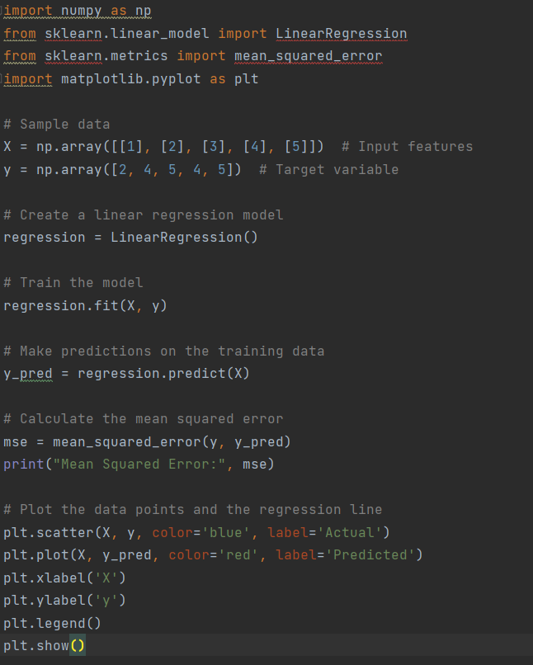
In this example, we start by importing the necessary libraries: numpy for numerical operations, scikit-learn for linear regression, matplotlib for data visualization, and mean_squared_error from scikit-learn metrics module.
Next, we define our sample data. We have an array X that represents the input features and an array y that represents the target variable.
We then create a Linear Regression object called regression. This will be our linear regression model.
To train the model, we call the fit() method on the regression object, passing in the input features X and the target variable y.
Once the model is trained, we can make predictions on the training data by calling the predict() method on the regression object and passing in X. The predicted values are stored in the y_pred array.
To evaluate the performance of our model, we calculate the mean squared error (MSE) between the actual target variable y and the predicted values y_pred. The MSE is a common metric used to measure the quality of regression models.
Finally, we visualize the data points and the regression line using matplotlib. The scatter() function is used to plot the actual data points, and the plot() function is used to plot the predicted regression line. We also add labels to the x-axis and y-axis and include a legend for clarity. The resulting plot will show the data points as blue dots and the regression line as a red line.
Running the code will output the mean squared error and display the scatter plot with the actual data points and the predicted regression line.
Notes:
In this example, we start by importing the necessary libraries: numpy for numerical operations, scikit-learn for linear regression, matplotlib for data visualization, and mean_squared_error from scikit-learn metrics module.
Next, we define our sample data. We have an array X that represents the input features and an array y that represents the target variable.
We then create a Linear Regression object called regression. This will be our linear regression model.
To train the model, we call the fit() method on the regression object, passing in the input features X and the target variable y.
Once the model is trained, we can make predictions on the training data by calling the predict() method on the regression object and passing in X. The predicted values are stored in the y_pred array.
To evaluate the performance of our model, we calculate the mean squared error (MSE) between the actual target variable y and the predicted values y_pred. The MSE is a common metric used to measure the quality of regression models.
Finally, we visualize the data points and the regression line using matplotlib. The scatter() function is used to plot the actual data points, and the plot() function is used to plot the predicted regression line. We also add labels to the x-axis and y-axis and include a legend for clarity. The resulting plot will show the data points as blue dots and the regression line as a red line.
Running the code will output the mean squared error and display the scatter plot with the actual data points and the predicted regression line.

Slide 20
2.Logistic Regression
A binary dependent variable—one with just two potential outcomes, like yes or no—and one or more independent variables are analysed using the statistical technique known as logistic regression.
Data is frequently divided into two or more groups using machine learning and data science techniques.A probability between 0 and 1 that represents the chance of the dependent variable falling into a certain category is the output of a logistic regression model.
Binary classification issues (where the dependent variable has two potential outcomes) and multiclass classification problems may both be solved using logistic regression models (where the dependent variable has more than two possible outcomes).The logistic function, which converts any input with a real value to a number between 0 and 1, serves as the foundation for the logistic regression model.
Given the values of the independent variables, the logistic function is used to model the likelihood of the dependent variable. The maximum likelihood estimation method is used to estimate the parameters of a logistic regression model.
The model may be used to forecast the likelihood that a fresh set of data points will fall within a specific category of the dependent variable once the parameters have been calculated. For a variety of prediction problems, the machine learning and data science sectors of finance, healthcare, and marketing frequently employ the popular and effective method of logistic regression.
In the graph:
The S-curve represents the logistic function, showing how the predicted probability (on the y-axis) changes with respect to the input features.
The "Threshold Value" (θ) is marked as a vertical line on the x-axis, dividing the curve into two regions.
'Y' represents the predicted outcome (0 or 1) based on whether the predicted probability is above or below the threshold value.

Slide 21
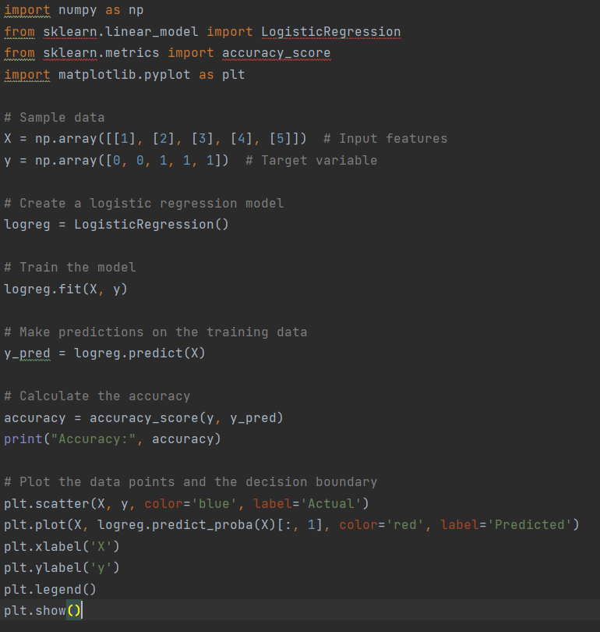
In this example, we start by importing the necessary libraries: numpy for numerical operations, scikit-learn for logistic regression, matplotlib for data visualization, and accuracy_score from scikit-learn's metrics module.
Next, we define our sample data. We have an array X that represents the input features and an array y that represents the target variable. The target variable is binary, with values of 0 or 1.
We then create a LogisticRegression object called logreg. This will be our logistic regression model.
To train the model, we call the fit() method on the logreg object, passing in the input features X and the target variable y.
Once the model is trained, we can make predictions on the training data by calling the predict() method on the logreg object and passing in X. The predicted values are stored in the y_pred array.
To evaluate the performance of our model, we calculate the accuracy by comparing the actual target variable y with the predicted values y_pred. The accuracy is a common metric used to measure the performance of classification models.
Finally, we visualize the data points and the decision boundary using matplotlib. The scatter() function is used to plot the actual data points, and the plot() function is used to plot the predicted probabilities of the positive class. The predicted probabilities are obtained using the predict_proba() method of the logreg object. We also add labels to the x-axis and y-axis and include a legend for clarity. The resulting plot will show the data points as blue dots and the decision boundary as a red curve.
Running the code will output the accuracy and display the scatter plot with the actual data points and the decision boundary.
Notes:
In this example, we start by importing the necessary libraries: numpy for numerical operations, scikit-learn for logistic regression, matplotlib for data visualization, and accuracy_score from scikit-learn's metrics module.
Next, we define our sample data. We have an array X that represents the input features and an array y that represents the target variable. The target variable is binary, with values of 0 or 1.
We then create a LogisticRegression object called logreg. This will be our logistic regression model.
To train the model, we call the fit() method on the logreg object, passing in the input features X and the target variable y.
Once the model is trained, we can make predictions on the training data by calling the predict() method on the logreg object and passing in X. The predicted values are stored in the y_pred array.
To evaluate the performance of our model, we calculate the accuracy by comparing the actual target variable y with the predicted values y_pred. The accuracy is a common metric used to measure the performance of classification models.
Finally, we visualize the data points and the decision boundary using matplotlib. The scatter() function is used to plot the actual data points, and the plot() function is used to plot the predicted probabilities of the positive class. The predicted probabilities are obtained using the predict_proba() method of the logreg object. We also add labels to the x-axis and y-axis and include a legend for clarity. The resulting plot will show the data points as blue dots and the decision boundary as a red curve.
Running the code will output the accuracy and display the scatter plot with the actual data points and the decision boundary.

Slide 22
3. Decision Trees
A supervised learning approach used for classification or regression analysis is known as a decision tree. It operates by recursively dividing the input data into smaller subsets according to the values of the input attributes and building a model that resembles a tree of decisions and potential outcomes. The root node of the decision tree algorithm is a representation of the complete dataset. Then, it decides which characteristic and matching threshold will produce subsets of the data that are as homogenous as feasible with regard to the target variable. The splitting criterion is determined by the feature and threshold that results in the most homogenous subgroups.
Notes:
Root Node:
The topmost node of the tree.
Represents the entire dataset and is split into child nodes based on a chosen feature.
Internal (Non-Leaf) Nodes:
Nodes other than the root node.
Each internal node represents a decision or test on a specific feature and splits the dataset into subsets accordingly.
Leaf Nodes (Terminal Nodes):
The endpoints of the tree.
Represent the final prediction or outcome.
In classification, each leaf node corresponds to a class label.
In regression, each leaf node contains a predicted numerical value.
Edges (Branches):
Connect nodes in the tree and represent the flow of data.
Each edge corresponds to a possible outcome of the feature test made at its parent node.
Subtree:
A subtree is a smaller tree within the larger Decision Tree.
It includes an internal node, its child nodes, and their descendants.
Subtrees are created by recursively splitting the dataset based on features.

Slide 23
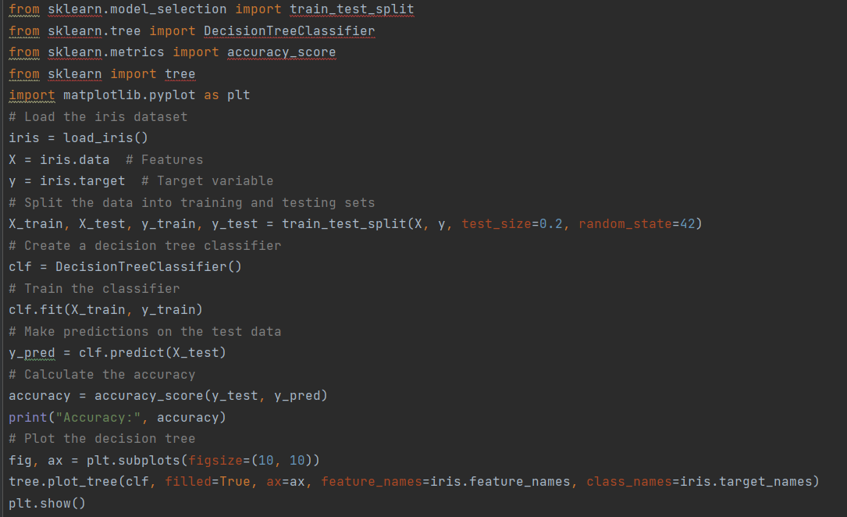
In this example, we start by importing the necessary modules from scikit-learn: load_iris to load the iris dataset, train_test_split to split the data into training and testing sets, DecisionTreeClassifier for creating the decision tree classifier, accuracy_score for calculating the accuracy, and tree for visualizing the decision tree.
We load the iris dataset using the load_iris() function and store the features in X and the target variable in y.
Next, we split the data into training and testing sets using train_test_split(). In this case, we allocate 20% of the data for testing, and set the random state to ensure reproducibility.
We create a DecisionTreeClassifier object called clf. This will be our decision tree classifier.
To train the classifier, we call the fit() method on the clf object, passing in the training data X_train and the corresponding target variable y_train.
Once the classifier is trained, we can make predictions on the test data by calling the predict() method on the clf object and passing in X_test. The predicted values are stored in the y_pred array.
To evaluate the performance of our model, we calculate the accuracy by comparing the predicted labels y_pred with the actual labels y_test using the accuracy_score() function from scikit-learn.
Finally, we visualize the decision tree using matplotlib. We create a figure and axes using subplots(), specify the size of the plot, and then use tree.plot_tree() to visualize the decision tree. We also pass in the feature names and class names to label the tree accordingly. The resulting plot will display the decision tree structure.
Running the code will output the accuracy and display the decision tree plot.
Notes:
In this example, we start by importing the necessary modules from scikit-learn: load_iris to load the iris dataset, train_test_split to split the data into training and testing sets, DecisionTreeClassifier for creating the decision tree classifier, accuracy_score for calculating the accuracy, and tree for visualizing the decision tree.
We load the iris dataset using the load_iris() function and store the features in X and the target variable in y.
Next, we split the data into training and testing sets using train_test_split(). In this case, we allocate 20% of the data for testing, and set the random state to ensure reproducibility.
We create a DecisionTreeClassifier object called clf. This will be our decision tree classifier.
To train the classifier, we call the fit() method on the clf object, passing in the training data X_train and the corresponding target variable y_train.
Once the classifier is trained, we can make predictions on the test data by calling the predict() method on the clf object and passing in X_test. The predicted values are stored in the y_pred array.
To evaluate the performance of our model, we calculate the accuracy by comparing the predicted labels y_pred with the actual labels y_test using the accuracy_score() function from scikit-learn.
Finally, we visualize the decision tree using matplotlib. We create a figure and axes using subplots(), specify the size of the plot, and then use tree.plot_tree() to visualize the decision tree. We also pass in the feature names and class names to label the tree accordingly. The resulting plot will display the decision tree structure.
Running the code will output the accuracy and display the decision tree plot.

Slide 24
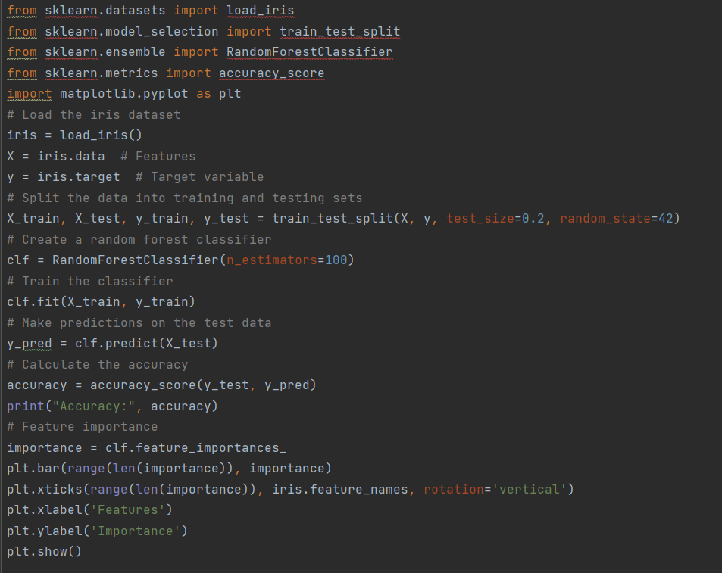
4. Random Forest
This method fits several Decision Tree classifiers in parallel, on different data set sub-samples and uses majority voting or averages for the outcome or final result.
In this example, we start by importing the necessary modules from scikit-learn: load_iris to load the iris dataset, train_test_split to split the data into training and testing sets, RandomForestClassifier for creating the random forest classifier, accuracy_score for calculating the accuracy, and matplotlib.pyplot for data visualization.
We load the iris dataset using the load_iris() function and store the features in X and the target variable in y.
Next, we split the data into training and testing sets using train_test_split(). In this case, we allocate 20% of the data for testing, and set the random state to ensure reproducibility.
We create a RandomForestClassifier object called clf. This will be our random forest classifier. In this example, we set the number of estimators (decision trees) to 100.
To train the classifier, we call the fit() method on the clf object, passing in the training data X_train and the corresponding target variable y_train.
Once the classifier is trained, we can make predictions on the test data by calling the predict() method on the clf object and passing in X_test. The predicted values are stored in the y_pred array.
To evaluate x performance of our model, we calculate the accuracy by comparing the predicted labels y_pred with the actual labels y_test using the accuracy_score() function from scikit-learn.
Additionally, we can analyze the feature importance in the random forest classifier. We can obtain the importance scores using the feature_importances_ attribute of the clf object. In this example, we visualize the feature importance using a bar plot, where the x-axis represents the features and the y-axis represents the importance scores.
Running the code will output the accuracy and display the feature importance plot.
Notes:
In this example, we start by importing the necessary modules from scikit-learn: load_iris to load the iris dataset, train_test_split to split the data into training and testing sets, RandomForestClassifier for creating the random forest classifier, accuracy_score for calculating the accuracy, and matplotlib.pyplot for data visualization.
We load the iris dataset using the load_iris() function and store the features in X and the target variable in y.
Next, we split the data into training and testing sets using train_test_split(). In this case, we allocate 20% of the data for testing, and set the random state to ensure reproducibility.
We create a RandomForestClassifier object called clf. This will be our random forest classifier. In this example, we set the number of estimators (decision trees) to 100.
To train the classifier, we call the fit() method on the clf object, passing in the training data X_train and the corresponding target variable y_train.
Once the classifier is trained, we can make predictions on the test data by calling the predict() method on the clf object and passing in X_test. The predicted values are stored in the y_pred array.
To evaluate x performance of our model, we calculate the accuracy by comparing the predicted labels y_pred with the actual labels y_test using the accuracy_score() function from scikit-learn.
Additionally, we can analyze the feature importance in the random forest classifier. We can obtain the importance scores using the feature_importances_ attribute of the clf object. In this example, we visualize the feature importance using a bar plot, where the x-axis represents the features and the y-axis represents the importance scores.
Running the code will output the accuracy and display the feature importance plot.

Slide 25
5. K-Nearest Neighbours or KNN
KNN classifies instances based on their similarity to training data. In the k - nearest neighbor rule, a test sample is assigned the class most frequently represented among the k nearest training samples. If two or more such classes exist, then the test sample is assigned the class with minimum average distance to it. [8]
i.e it classifies points based on their position in the graph. For eg if the output cluster is closer to a blue group than a red group then it would be called a member of the blue group. This approach indicates that KNN can be used to either group known data or predict where unknown data should lie.

Slide 26
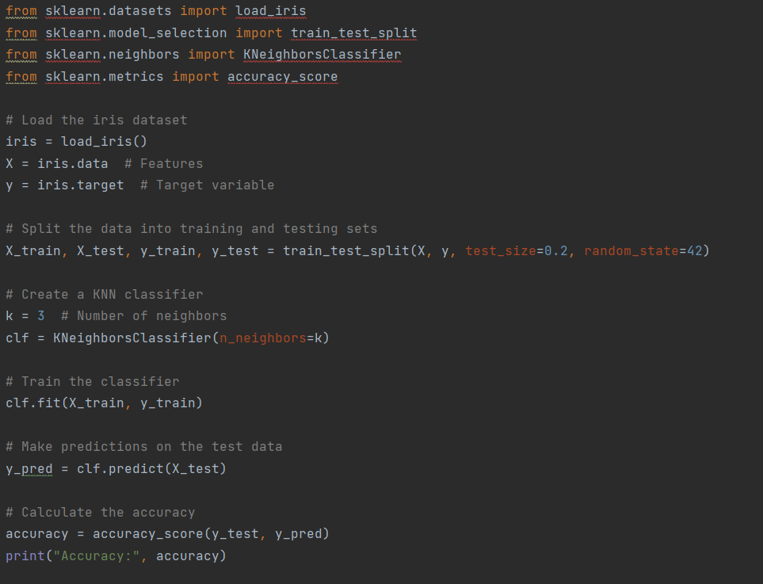
In this example, we start by importing the necessary modules from scikit-learn: load_iris to load the iris dataset, train_test_split to split the data into training and testing sets, KNeighborsClassifier for creating the KNN classifier, and accuracy_score for calculating the accuracy.
We load the iris dataset using the load_iris() function and store the features in X and the target variable in y.
Next, we split the data into training and testing sets using train_test_split(). In this case, we allocate 20% of the data for testing, and set the random state to ensure reproducibility.
We create a KNeighborsClassifier object called clf. This will be our KNN classifier. In this example, we set the number of neighbors (k) to 3.
To train the classifier, we call the fit() method on the clf object, passing in the training data X_train and the corresponding target variable y_train.
Once the classifier is trained, we can make predictions on the test data by calling the predict() method on the clf object and passing in X_test. The predicted values are stored in the y_pred array.
To evaluate the performance of our model, we calculate the accuracy by comparing the predicted labels y_pred with the actual labels y_test using the accuracy_score() function from scikit-learn.
Running the code will output the accuracy of the KNN classifier on the test data.
Notes:
In this example, we start by importing the necessary modules from scikit-learn: load_iris to load the iris dataset, train_test_split to split the data into training and testing sets, KNeighborsClassifier for creating the KNN classifier, and accuracy_score for calculating the accuracy.
We load the iris dataset using the load_iris() function and store the features in X and the target variable in y.
Next, we split the data into training and testing sets using train_test_split(). In this case, we allocate 20% of the data for testing, and set the random state to ensure reproducibility.
We create a KNeighborsClassifier object called clf. This will be our KNN classifier. In this example, we set the number of neighbors (k) to 3.
To train the classifier, we call the fit() method on the clf object, passing in the training data X_train and the corresponding target variable y_train.
Once the classifier is trained, we can make predictions on the test data by calling the predict() method on the clf object and passing in X_test. The predicted values are stored in the y_pred array.
To evaluate the performance of our model, we calculate the accuracy by comparing the predicted labels y_pred with the actual labels y_test using the accuracy_score() function from scikit-learn.
Running the code will output the accuracy of the KNN classifier on the test data.

Slide 27
Gradio
Gradio is a Python library that is primarily used for creating user interfaces for machine learning models. It simplifies the process of building and deploying interactive web-based interfaces that allow users to interact with machine learning models without needing deep knowledge of web development
Creating User Interfaces: Gradio enables data scientists and machine learning practitioners to build web-based user interfaces (UIs) for their machine learning models. These UIs can include input forms where users can provide data, and output displays to see the model's predictions or results.
Interactivity: Gradio offers a high level of interactivity, allowing users to input data, receive model predictions, and visualize the results in real-time. This makes it useful for tasks like image classification, text generation, and more.
Model Deployment: Gradio simplifies the deployment process of machine learning models with web interfaces. It provides an easy way to turn a trained model into a web application that can be hosted and accessed by others.
Customization: Gradio offers flexibility in designing the user interface. Users can customize the appearance and functionality of the UI components to match their specific needs and preferences.
Integration: Gradio can be integrated with various machine learning frameworks and libraries like TensorFlow, PyTorch, and scikit-learn, making it versatile and compatible with a wide range of models.

Slide 28
How to use google colab
Open google drive
Go to new
Go to more apps
Go to connect
Search and add google colab
Go back and from new use google colab

Slide 29
How to get OpenAI API key
Go to OpenAI's Platform website at platform.openai.com and sign in with an OpenAI account.
Click your profile icon at the top-right corner of the page and select "View API Keys."
Click "Create New Secret Key" to generate a new API key.

Slide 30
What is Natural Language Processing
Natural Language Processing (NLP) is a field of artificial intelligence that focuses on enabling computers to understand, interpret, and generate human language. It involves techniques to analyze text and speech, extracting meaning, sentiment, and context. NLP powers applications like chatbots, language translation, and sentiment analysis, bridging the gap between human communication and machine understanding. Through algorithms and machine learning, NLP enhances communication and interaction between humans and computers.

Slide 31
Some of the Applications of NLP
Chatbots and Virtual Assistants: NLP is used to create intelligent chatbots and virtual assistants that can interact with users, answer questions, and perform tasks through natural language conversations.
Language Translation: NLP powers language translation tools, enabling automatic translation of text or speech from one language to another, facilitating cross-cultural communication.
Sentiment Analysis: NLP can analyze text to determine the sentiment or emotion behind it, helping companies gauge public opinion, customer feedback, and social media reactions.
Speech Recognition: NLP enables computers to convert spoken language into text, used in applications like voice assistants, transcription services, and accessibility tools.
Text Summarization: NLP algorithms can automatically generate concise summaries of lengthy texts, aiding in information extraction and content digestion.

Slide 32
Neural networks are a fundamental component of deep learning and artificial intelligence.
Input Layer: The input layer is where data is initially fed into the neural network. It consists of nodes, each representing a feature or attribute of the input data. For example, in image recognition, each node might represent a pixel value. The number of nodes in the input layer is determined by the dimensionality of the input data.
Hidden Layers: Hidden layers are intermediary layers between the input and output layers. These layers process the input data through a series of weighted connections and activation functions. Each node in a hidden layer receives inputs from the previous layer, applies weights to those inputs, sums them up, and then passes the result through an activation function. The activation function introduces non-linearity, allowing the network to learn complex patterns and relationships in the data. Deep neural networks have multiple hidden layers, forming the "deep" in deep learning. The nodes and connections in hidden layers are where the network's learning and feature extraction occur.
Output Layer: The output layer produces the final results of the neural network's computation. The number of nodes in the output layer depends on the nature of the task. For instance, in a binary classification task, there might be a single node with an activation indicating the probability of belonging to one class. In multi-class classification, each node may represent the probability of belonging to a specific class. In regression tasks, the output layer might produce a continuous value. The activation function used in the output layer depends on the task as well – for example, softmax for classification and linear activation for regression.

Slide 33
Tokenisers
Tokenizers play a crucial role in natural language processing and language models. They are responsible for breaking down a piece of text, such as a sentence or document, into smaller units called "tokens." These tokens are usually words or subword units, and they serve as the fundamental building blocks for various NLP tasks and language models.
Tokenization: Tokenization is the process of dividing a text into smaller units, which are called tokens. These tokens can be words, subwords (like morphemes or subword pieces), or even characters, depending on the granularity of tokenization used. Tokenization is often one of the first steps in many NLP tasks.
Word Tokenization: In word tokenization, the text is divided into individual words. For example, the sentence "I love natural language processing" would be tokenized into the following tokens: ["I", "love", "natural", "language", "processing"].
Subword Tokenization: Subword tokenization breaks text into smaller units that are not necessarily whole words. This is particularly useful for handling languages with complex word forms and for optimizing the vocabulary size in neural language models. Subword tokenization techniques, such as Byte-Pair Encoding (BPE) or SentencePiece, can split words into subword pieces. For example, "unhappiness" might be tokenized into ["un", "happiness"].
Character Tokenization: In character tokenization, the text is broken down into individual characters. This is the finest level of granularity and is often used for tasks like text generation.
Vocabulary: Tokenizers often work with a predefined vocabulary that contains a list of all possible tokens that the model can recognize and generate. The vocabulary size impacts the model's memory usage and computational requirements.
Token IDs: Each token in a tokenizer's vocabulary is associated with a unique token ID. These IDs are used internally by the model to represent tokens. For instance, "cat" might have a token ID of 42.
Special Tokens: Tokenizers usually include special tokens like "[CLS]" (classification), "[SEP]" (separator), "[PAD]" (padding), and "[MASK]" (mask) that have specific roles in various NLP tasks. For example, BERT uses [CLS] and [SEP] tokens for sentence classification tasks.

Slide 34
Langchain
What is LangChain?
LangChain is a library that helps developers build applications powered by large language models (LLMs). It does this by providing a framework for connecting LLMs to other sources of data, such as the internet or your personal files. This allows developers to chain together multiple commands to create more complex applications.
Why is LangChain important?
There are several reasons why LangChain is an important tool for developers. First, it makes it easier to build applications that use LLMs. LLMs are complex models that can be difficult to use directly. LangChain provides a simple interface that makes it easy to connect LLMs to your application.
Second, LangChain allows you to connect LLMs to other sources of data. This is important because LLMs are trained on massive datasets of text and code. However, they can only access the information that is contained in those datasets. By connecting LLMs to other sources of data, you can give them access to a wider range of information. This can make your applications more powerful and versatile. Langchain provides a number of features that make it a valuable asset for any developer

Slide 35
What are LLMs
A large language model (LLM) is a type of artificial intelligence (AI) algorithm that uses deep learning techniques and massively large data sets to understand, summarise, generate and predict new content. The term generative AI also is closely connected with LLMs, which are, in fact, a type of generative AI that has been specifically architected to help generate text-based content.

